Slide 1
Manufacturing Task Tracker (MTT) 2017 Updates - Phase 3 September, 2017

Slide 2
SecureIP/MTT Interface
In the past, MTT employee lists were maintained by MTT
Facility Administrators using the Data Maintenance/Employee
Maintenance page. The new interface with SecureIP will keep the list
updated automatically. (*)
The following employee updates will be pushed to MTT
New Hires
Transfers
Terminations
Employee Data Changes (names, etc.)
Nightly batch job runs to update MTT employee table
@ 8 PM CST
Report sent via email to Facility Administrators for each site weekly
on Wednesday @ 8 PM CST (includes Employee Maint Updates Last
7 Days, Unassigned Roles, Role Listing, Employee Listing)
*Virtual sites excluded from automated update : Global Technology, NAC EHS,
Continuous Improvement Group (Blackshirts)
Notes:
An image of the MTT screen would be here. Also, if you are going to have a website with information about the MTT (faqs), this would be a good page to link to it.

Slide 3
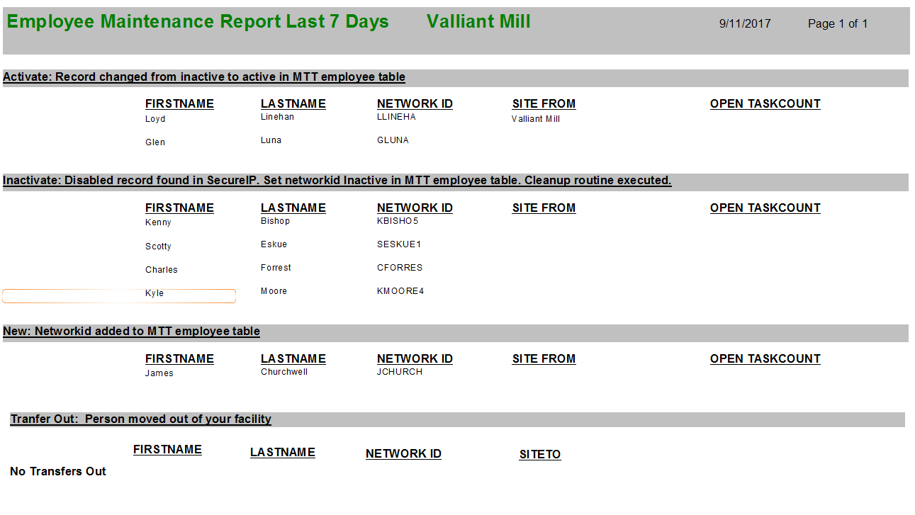
SecureIP/MTT Interface - Reports
Employee Maintenance Report Last 7 Days - This report will list any
changes to the MTT employee table based on changes from SecureIP in the last 7 days.
Facility Admin needs to Review to ensure the SecureIP changes are valid for your facility.
Section Definitions
Inactivate - Disabled record found in SecureIP. Set network ID Inactive in MTT employee table. Cleanup routine executed.
Activate - Record changed from inactive to active in MTT employee table
New – Network ID added to MTT employee table
Transfer In - Person moved into your facility
Transfer Out - Person moved out of your facility
Notes:
An image of the MTT screen would be here. Also, if you are going to have a website with information about the MTT (faqs), this would be a good page to link to it.

Slide 4
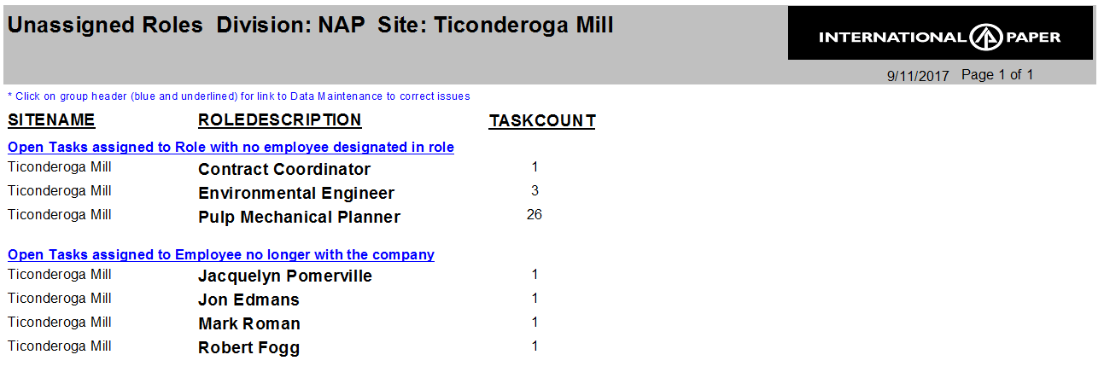
SecureIP/MTT Interface - Reports
Unassigned Roles Report
This report contains the exceptions and names assigned to roles.
The Facility Administrator is responsible for:
1) Any open task assigned to a role has at least one specific name assigned to the role.
2) Reassigning open tasks assigned to a person that has left the company
3) Any MOC default approver role has at least one specific name assigned to the role.
Notes:
An image of the MTT screen would be here. Also, if you are going to have a website with information about the MTT (faqs), this would be a good page to link to it.

Slide 5
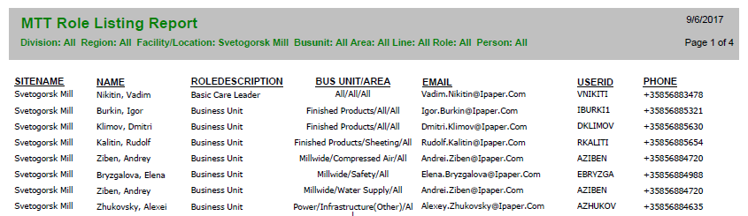
SecureIP/MTT Interface - Reports
Role Listing – This report is a listing of who is assigned to roles. This should be kept up to date, and reviewed periodically
Notes:
An image of the MTT screen would be here. Also, if you are going to have a website with information about the MTT (faqs), this would be a good page to link to it.

Slide 6
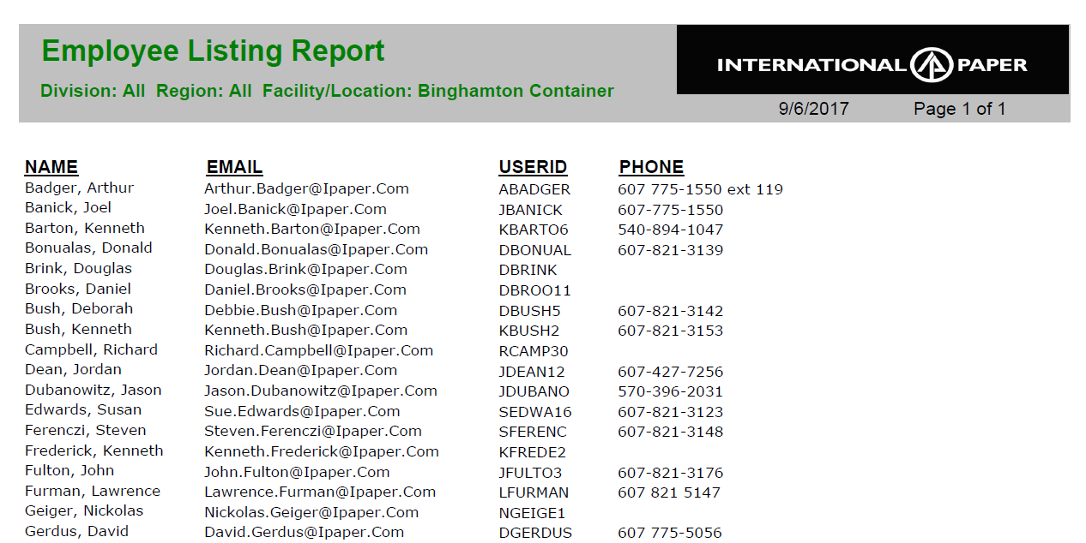
SecureIP/MTT Interface - Reports
Employee Listing – This report is a list of all active employees for your information only.
Notes:
An image of the MTT screen would be here. Also, if you are going to have a website with information about the MTT (faqs), this would be a good page to link to it.

Slide 7
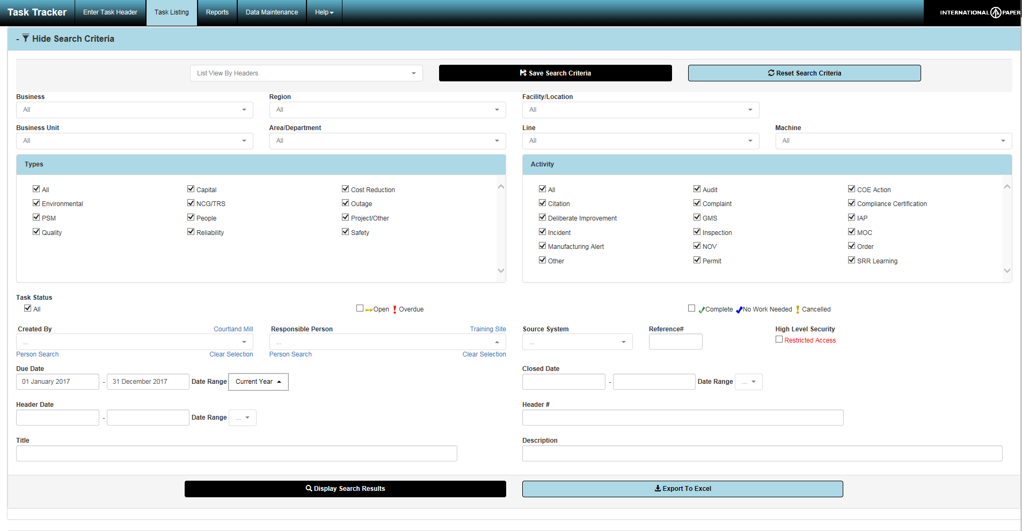
MTT Color Scheme Updates – Task Search
MTT color scheme has been updated to have a more modern look
and feel
Notes:
An image of the MTT screen would be here. Also, if you are going to have a website with information about the MTT (faqs), this would be a good page to link to it.

Slide 8
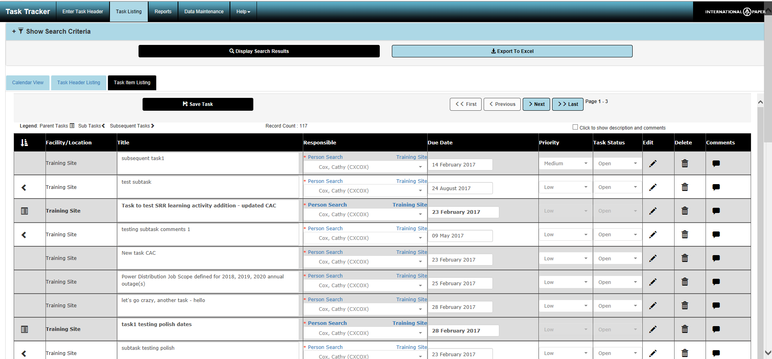
MTT Color Scheme Updates – Task Listing
MTT color scheme has been updated to have a more modern look
and feel
Notes:
An image of the MTT screen would be here. Also, if you are going to have a website with information about the MTT (faqs), this would be a good page to link to it.

Slide 9
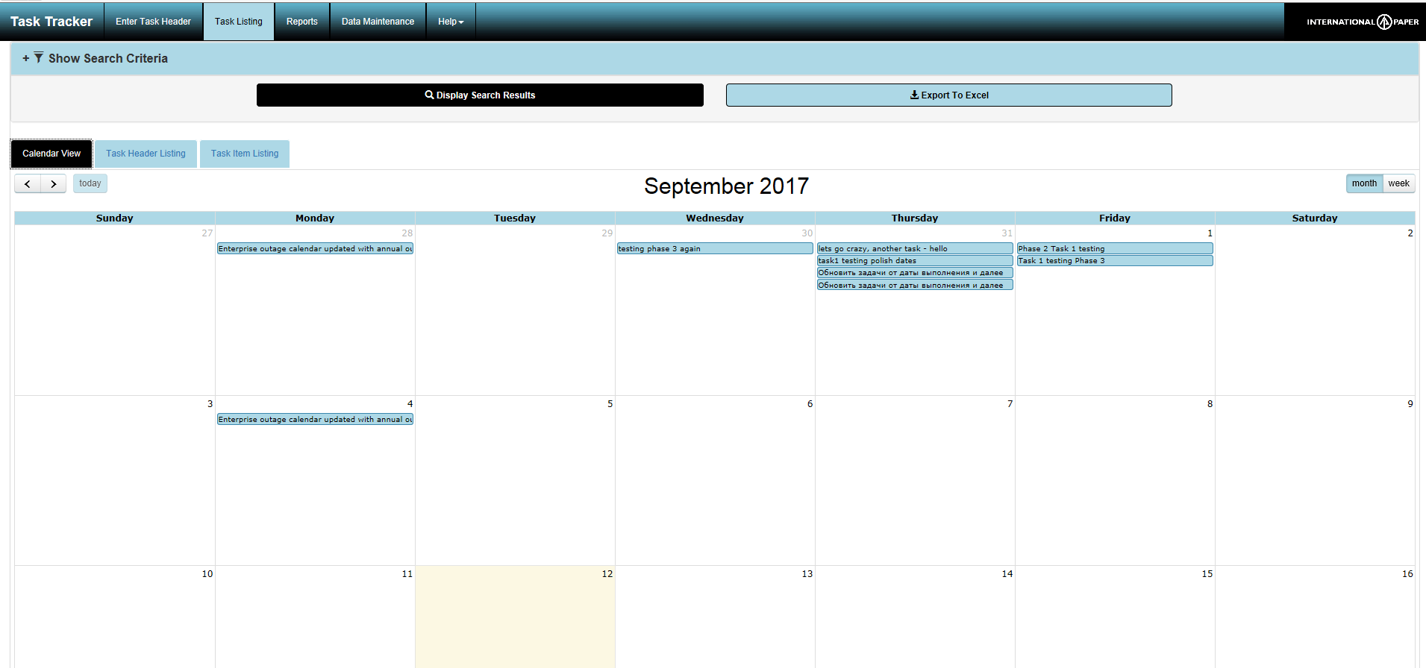
MTT Color Scheme Updates – Calendar
MTT color scheme has been updated to have a more modern look
and feel
Notes:
An image of the MTT screen would be here. Also, if you are going to have a website with information about the MTT (faqs), this would be a good page to link to it.

Slide 10
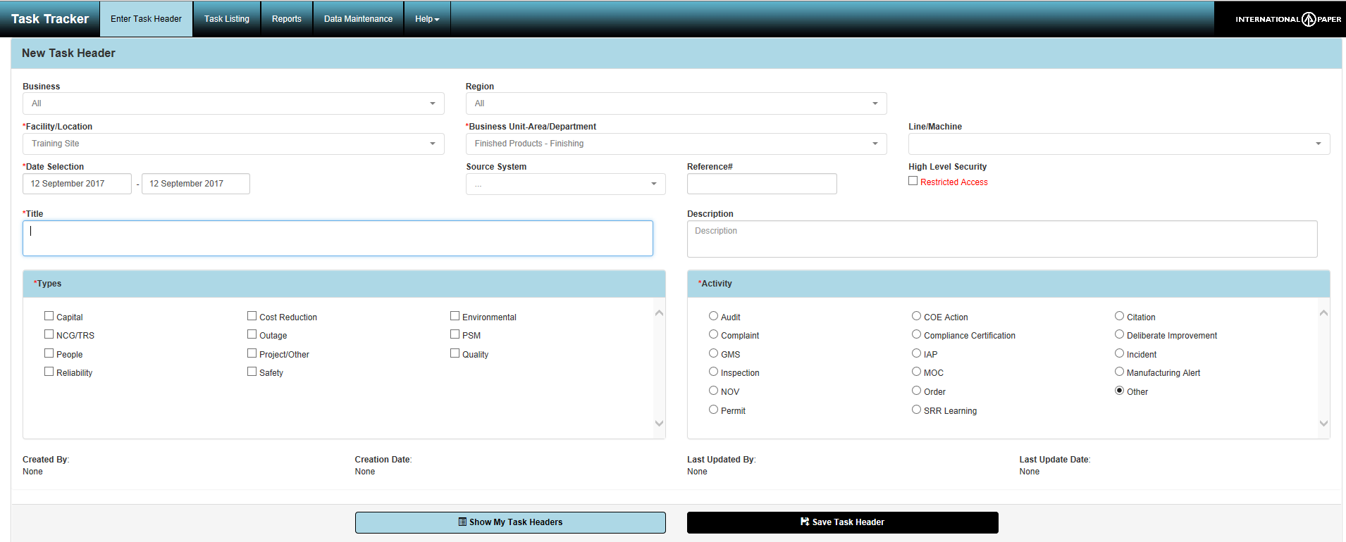
MTT Color Scheme Updates – Enter Task Header
MTT color scheme has been updated to have a more modern look
and feel
Notes:
An image of the MTT screen would be here. Also, if you are going to have a website with information about the MTT (faqs), this would be a good page to link to it.

Slide 11
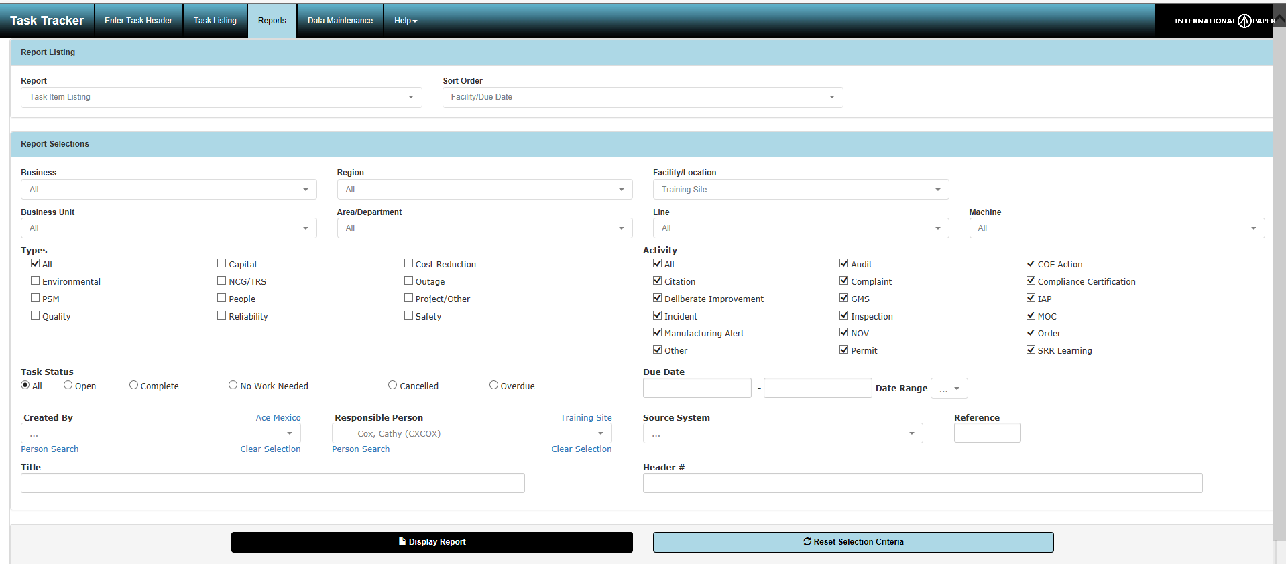
MTT Color Scheme Updates – Reports
MTT color scheme has been updated to have a more modern look
and feel
Notes:
An image of the MTT screen would be here. Also, if you are going to have a website with information about the MTT (faqs), this would be a good page to link to it.

Slide 12
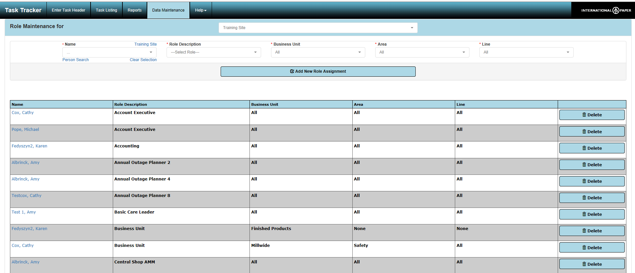
MTT Color Scheme Updates – Data Maintenance
MTT color scheme has been updated to have a more modern look
and feel
Notes:
An image of the MTT screen would be here. Also, if you are going to have a website with information about the MTT (faqs), this would be a good page to link to it.

Slide 13
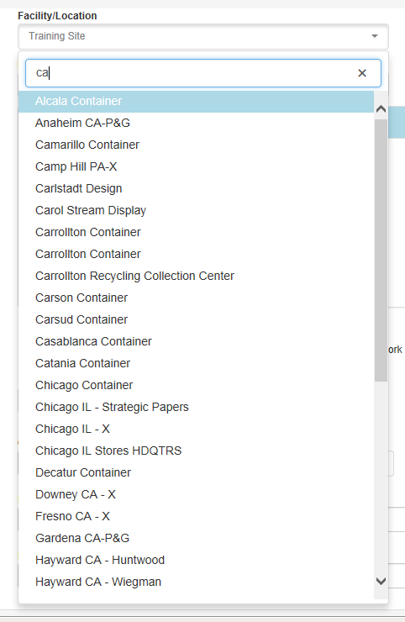
Dropdown Type Ahead Feature
All MTT dropdowns have been converted to use type ahead search.
Start typing whatever you are looking for and the list will locate
matching entries.
Notes:
An image of the MTT screen would be here. Also, if you are going to have a website with information about the MTT (faqs), this would be a good page to link to it.

Slide 14
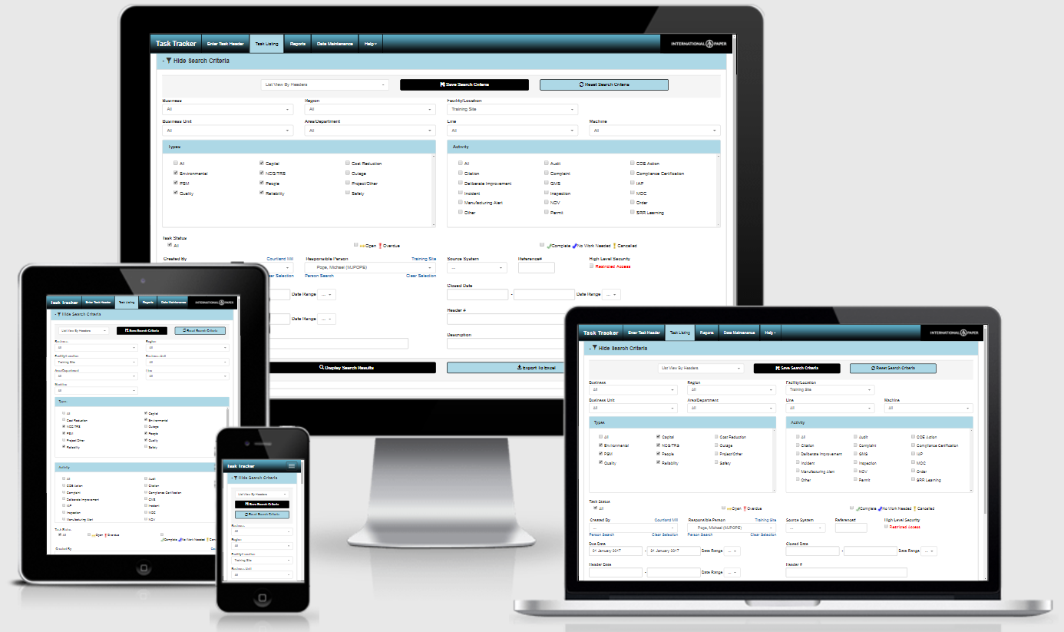
Mobile Enabled
MTT has been converted to a responsive design so that it can be used on any device or browser. The MTT screens will resize based on the device size. You still have to be connected to the IP network in order to connect to MTT.
Notes:
An image of the MTT screen would be here. Also, if you are going to have a website with information about the MTT (faqs), this would be a good page to link to it.

Slide 15
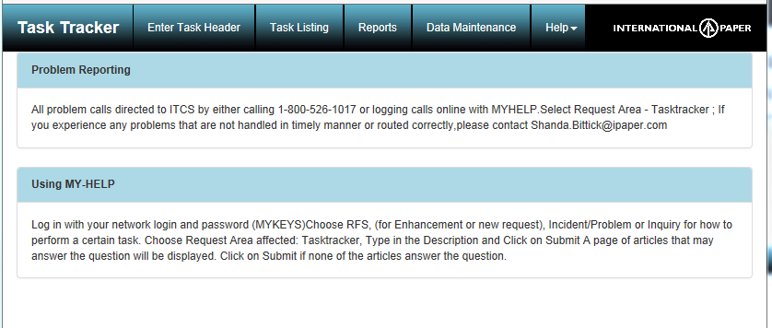
MTT Help
A new request area has been added to My-Help for MTT. When you have an issue
requiring MTT support attention, please select or ask for Tasktracker as the request area for the ticket. This will get the ticket assigned to the appropriate team
quicker.
Notes:
An image of the MTT screen would be here. Also, if you are going to have a website with information about the MTT (faqs), this would be a good page to link to it.

